Slide 1
Pancasila as the State Ideology Session 02
Course : CB Pancasila
Effective Period : 2017

Slide 2

Student will be able to explain Pancasila as the state ideology and the system of nation philosophy
Learning Objectives
barbarabray.net

Slide 3
Pancasila Relationship with the 1945 Opening
Pancasila: Rechts Idee
Opening
Body of 1945 Constitution
People

Slide 4

Implementation of Pancasila in the State Policy
bp.blogspot.com
Politics
Economic
Culture social
Defense and security

Slide 5
Definition of Ideology
Ideology is derived from the Greek word meaning idein that look, or Idea meaningful expression, posture, ideas, thoughts. Logic means teaching. Or logos which means science.

Slide 6
In general, ideology is a collection of thoughts, ideas, and beliefs that are systematically directing a person's behavior in various areas of life, such as politics, legal, defense and security, social, cultural and religious fields.

Slide 7
Pancasila in the Indonesia’s Constitution (UUD 1945)
Basic Thoughts in the Preambule
1st thought : Unity
2nd thought : Social Justice
3rd thought : Sovereignty of the People
4th thought : Belief in the one and only God

Slide 8

Pancasila and the World Ideology
Liberalism
Comunism
Socialism
Capitalism
cliparpanda.com

Slide 9
Pancasila and Religion
Pancasila acknowledge the existence of God, although Indonesia is not the state religion

Slide 10


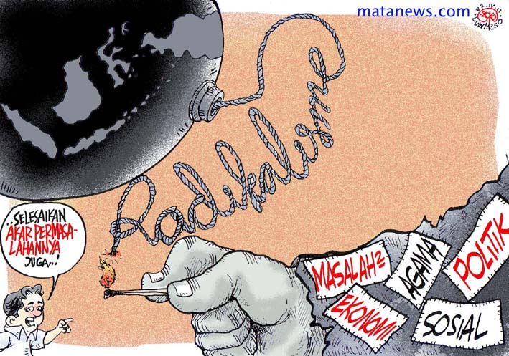
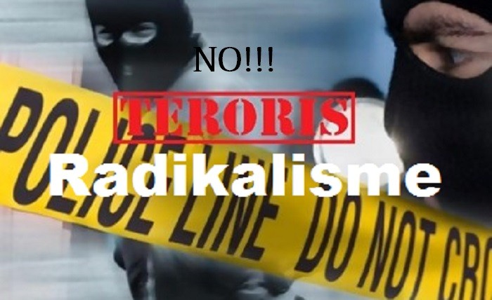
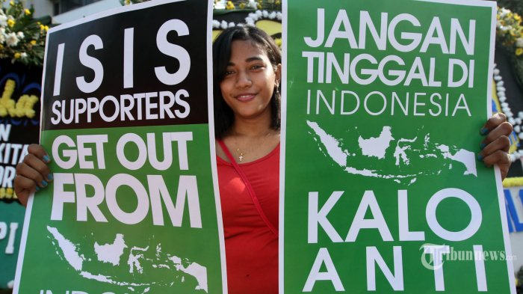
Discussion
Do you think ideology of Pancasila still relevant to the present?
What your opinion if somebody want to change Pancasila with other ideology

Slide 11
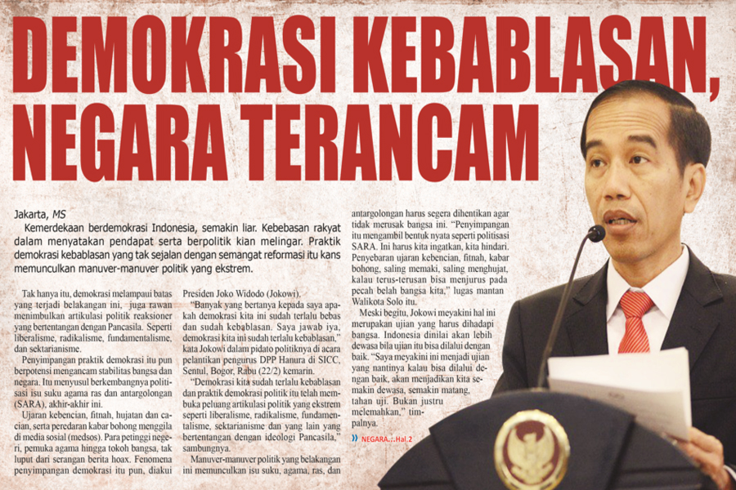
Case study
Read the article based on the following link …. http://mediasulut.co/detailpost/demokrasi-kebablasan-negara-terancam
Give your opinion about it!

Slide 12
Question and Answer
?

Slide 13
References
Tim Penulis CB: Pancasila (2014). Diktat Kuliah Character Building: Pancasila. Binus University: CBDC, 000
Materi Ajar Matakuliah Pendidikan Pancasila (2013). Buku Modul Kuliah Pancasila oleh Direktorat Pembelajaran dan Kemahasiswaan Direktorat Jenderal Pendidikan Tinggi Depdiknas , Kementerian Pendidikan dan Kebudayaan RI.
Gambar Learning Objective: barbarabray.net
Gambar Bendera Pancasila: bp.blogspot.com
Gambar World: clipartpanda.com
Gambar waspada komunis: http://buletininfo.com/cegah-paham-komunisme-dan-radikalisme/
Gambar anti ISIS: http://www.kompasiana.com/semuellusi/radikalisme-sukses-kandaskan-globalisme-bagaimana-nasib-indonesia_585a5ca1e3afbda3318a83a2
Gambar no radikalisme: https://lampungpro.com/post/2292/radikalisme-musuh-besar-masyarakat-indonesia
gambar karikatur radikalisme: http://www.kompasiana.com/ridwan78/anatomi-radikalisme-islam-di-indonesia-bagian-kedua_569d18ec119773da13f1aeca
Gambar pancasila sebagai ideologi: https://redaksiindonesia.com/read/pancasila-dalam-percobaan.html

